Slide 1
Ранние годы(THE EARLY YEARS)
Author: Golovachev Danila
Group: Y2431
1

Slide 2
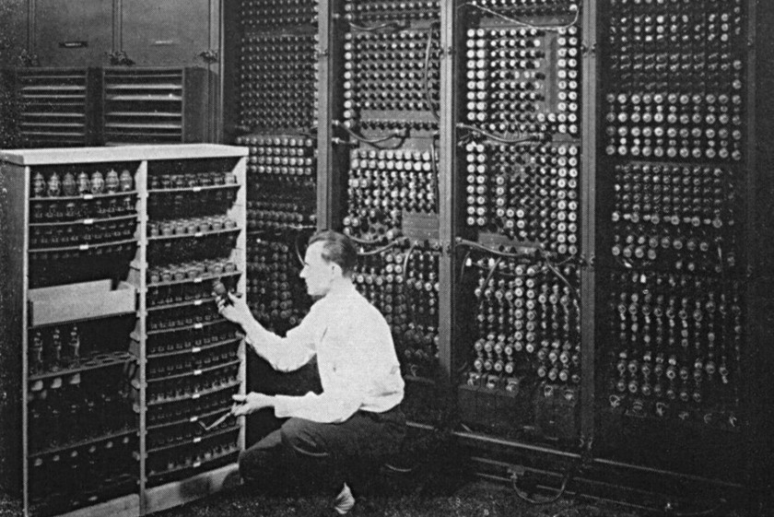
One of the first computers
2

Slide 3
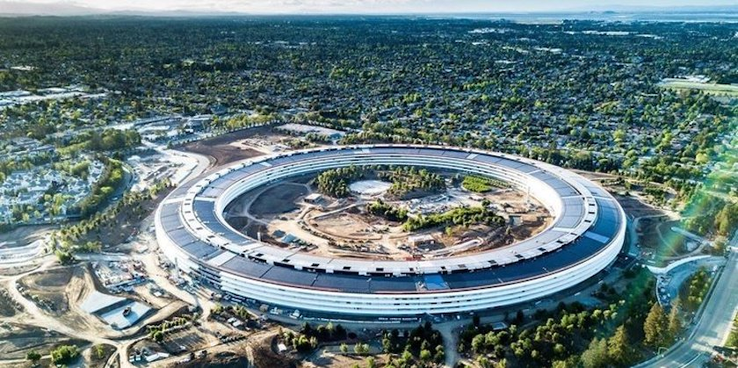
Silicon Valley
3

Slide 4
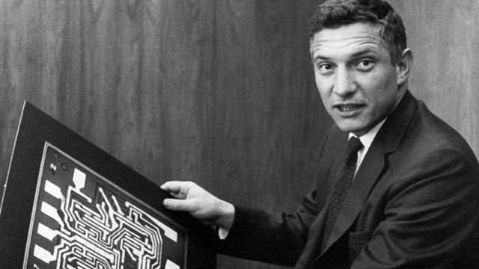
Robert Noyce
4

Slide 5
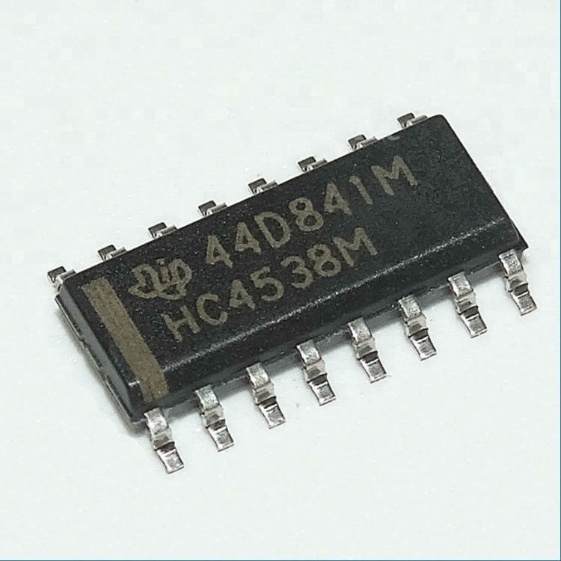
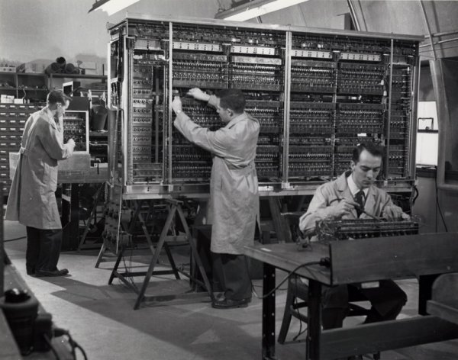
Integrated circuit
5

Slide 6
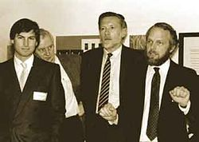
The first personal computers in the masses
6

Slide 7
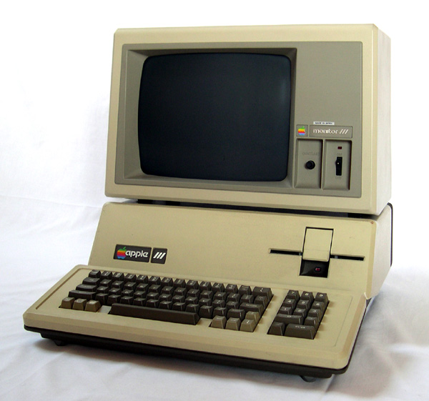
Apple III
7

Slide 8
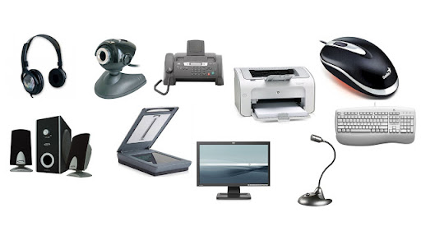
Computer peripherals
8

Slide 9

9

Slide 10
Questions
Who was one of the authors of the integrated circuit?
Which company was the first to start producing computer peripherals?
10

Slide 11
Thanks for the attention
12

